Slide 1
Part 2

Slide 2
Content
1. What is Maker DAO?
Maker DAO brief introduction
How to create DAI
The benefit using stable coin –DAI
Compared with other stable coins
2. Maker DAO’s ecosystem
Participate
Keeper
Auction Bidder
MKR holder
3. How to use DAI
Basic deposit
Go long and go short
Use leverage
An analogy with a home mortgage

Slide 3
Content
4. Maker DAO system design
DSR
Collateral auction
Surplus auction
Debt auction
5. Go further in liquidation, DAR and flash loan with examples
6. The differences in Liquidation 1.0/1.2/2.0
7. How different functions make system stable

Slide 4
Content
8. Detailed analysis (auction flow, data visualization)
9. Case study
Black swan, 5.24 plummet
PSM to after Black swan
D3M soared (AAVE and Maker DAO)
Lending protocol “bZx” hacked)
Compare Maker Dao and LUSD (Whether really decentralized)
LUSD first use Dutch auction!
Lending process
Stablecoin mechanism
Token Mode
Liquidation mechanism

Slide 5
Deposit Withdraw
Repay Borrow

Slide 6
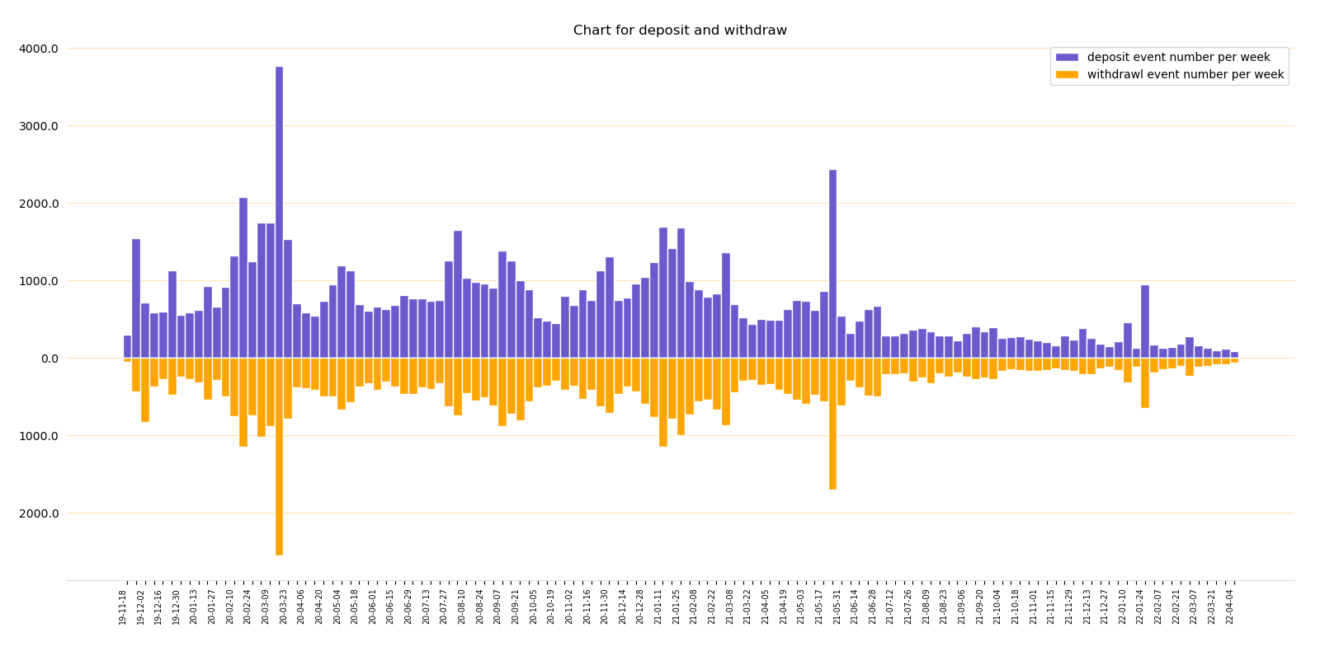
Deposit and withdraw (numbers)
The figure shows the distribution of the number of Deposits and withdraws, using the sum, and the unit time is 7 days.
The distribution of mirror images is adopted, with deposit on the top and withdraw on the bottom.
Although the overall is the same, there is still a difference, and the red curve shows the difference.

Slide 7
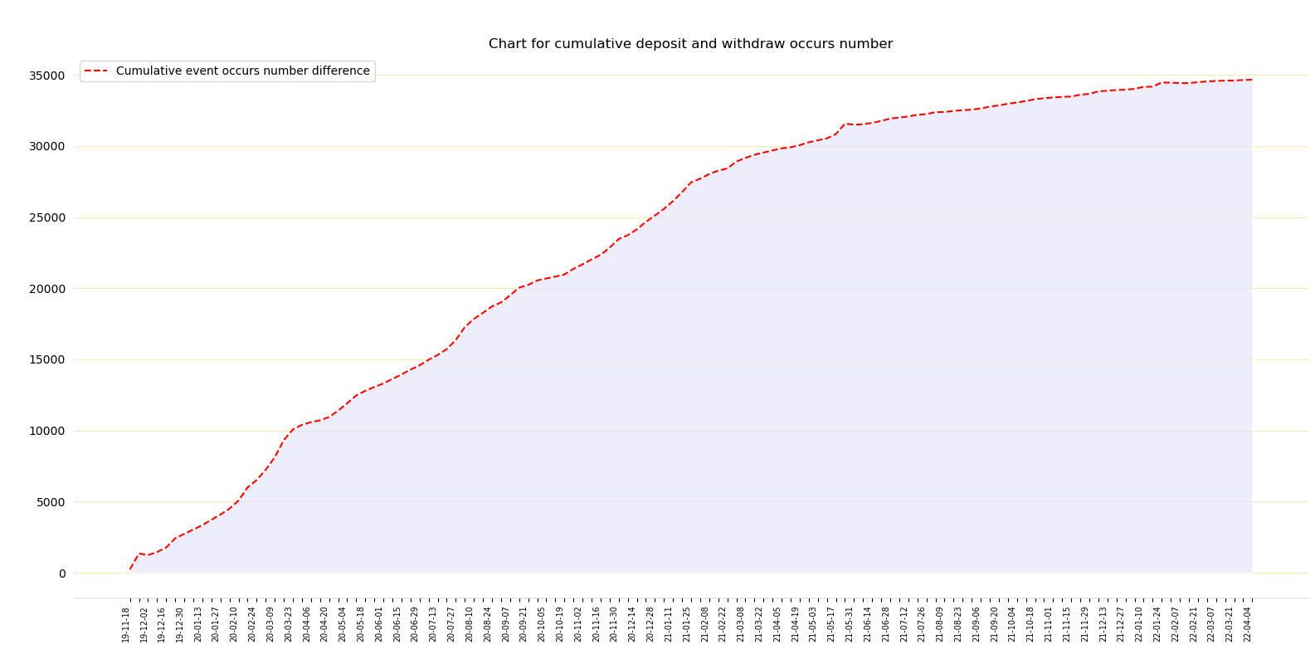

Slide 8
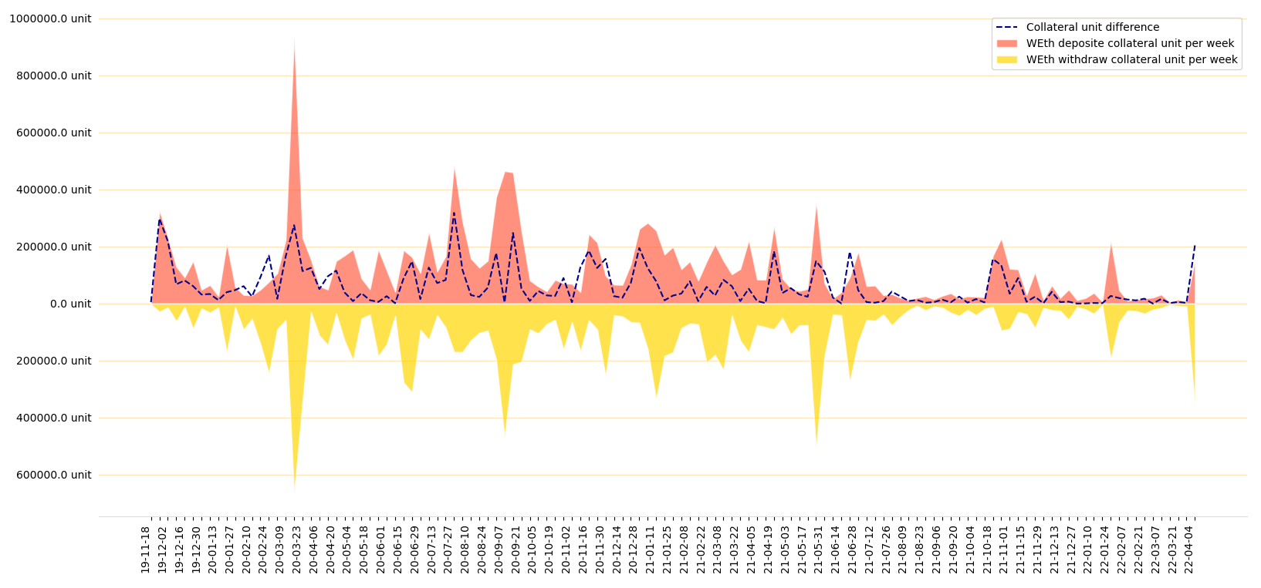

Slide 9
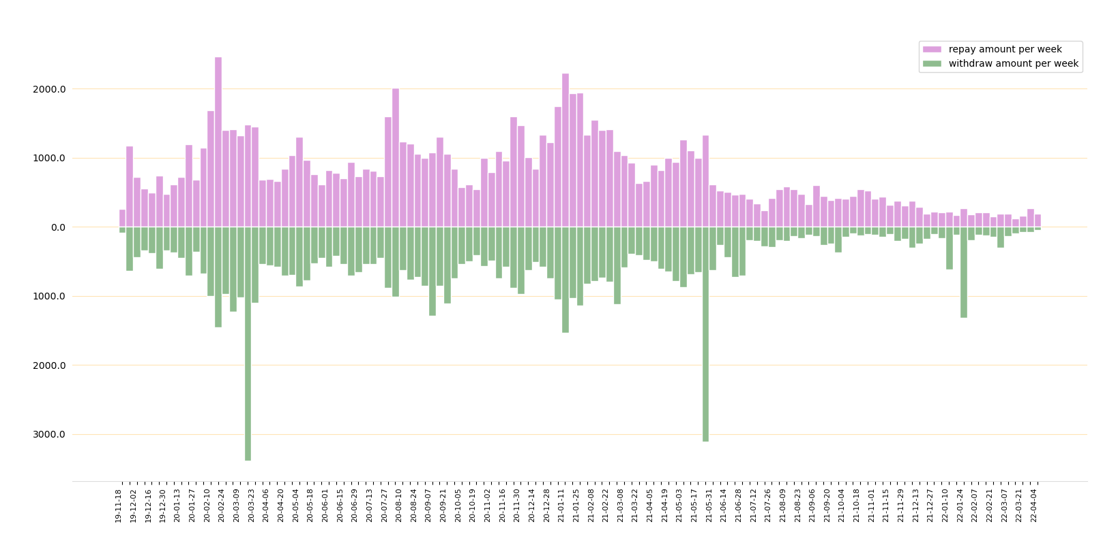
Borrow and Repay (numbers)
The figure shows the distribution of the number of borrows of repay, the number is calculated using the sum, and the unit time is 7 days.

Slide 10
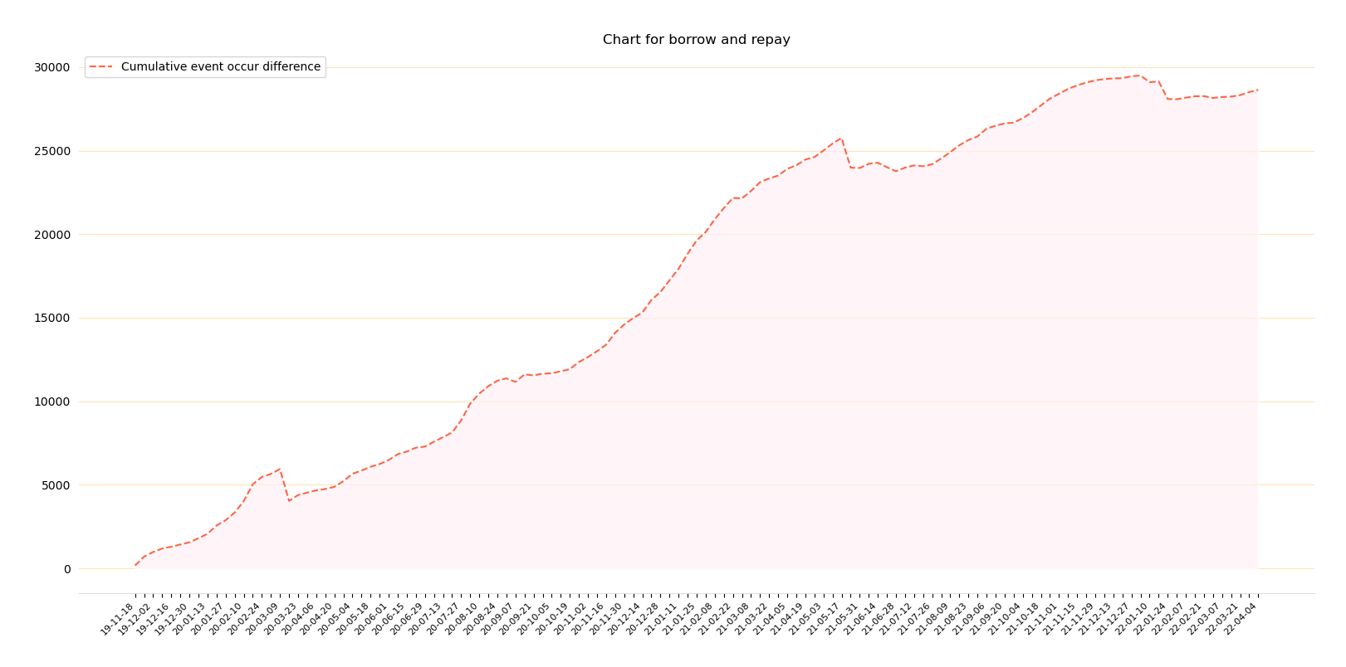

Slide 11
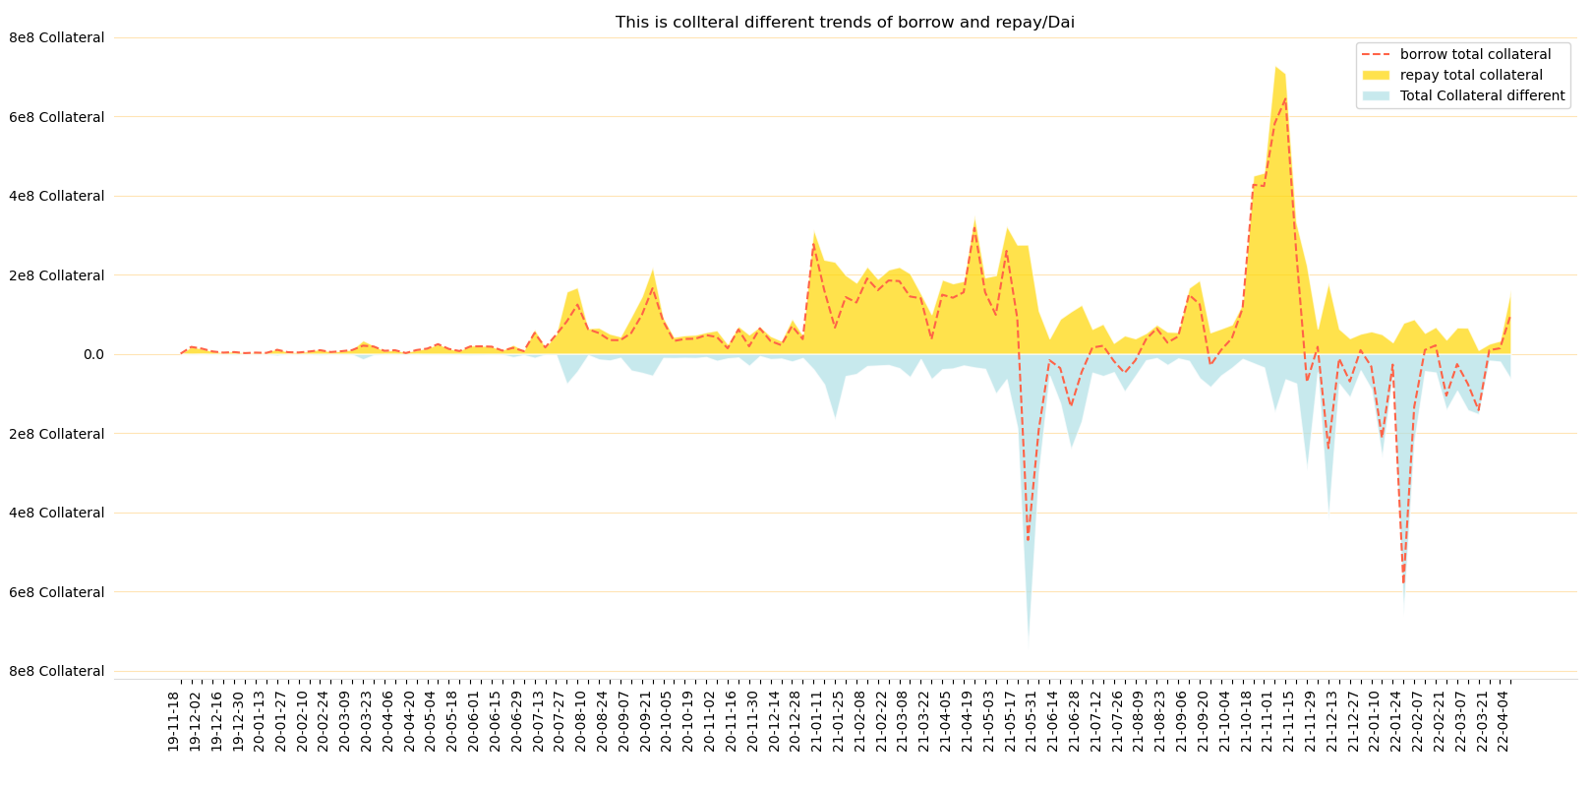
Borrow and repay (amount of DAI)
This graph shows the change in the distribution of borrow and repay transaction values, in DAI

Slide 12
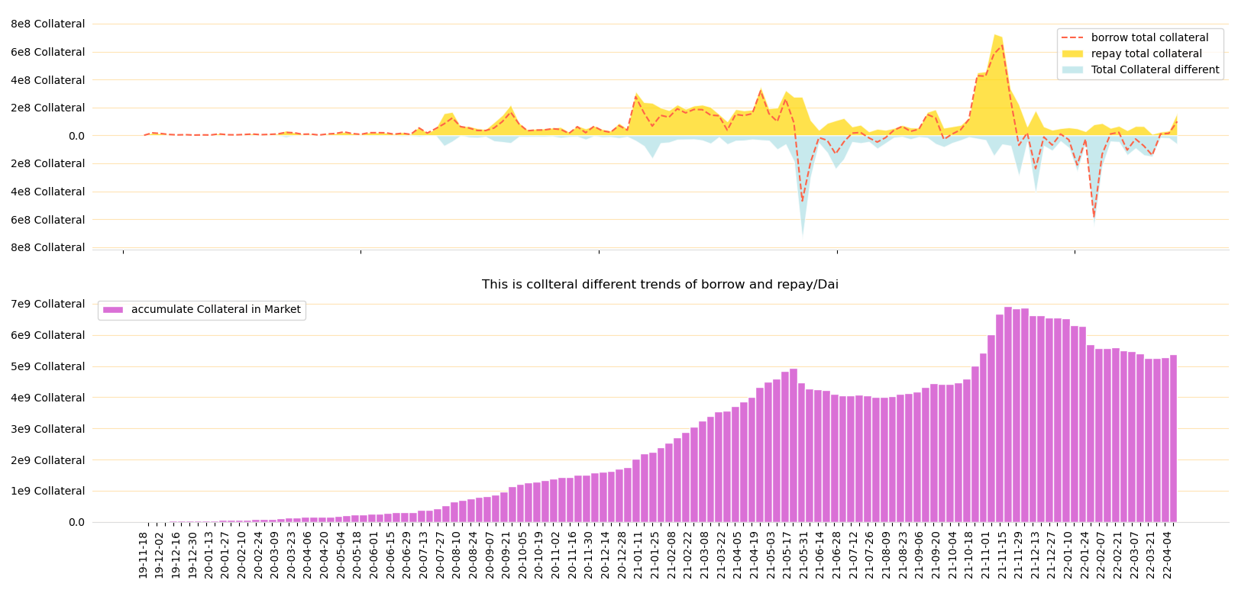
The amount of DAI circulating in the market is the area formed by the red line and the coordinate axis in the above figure

Slide 13
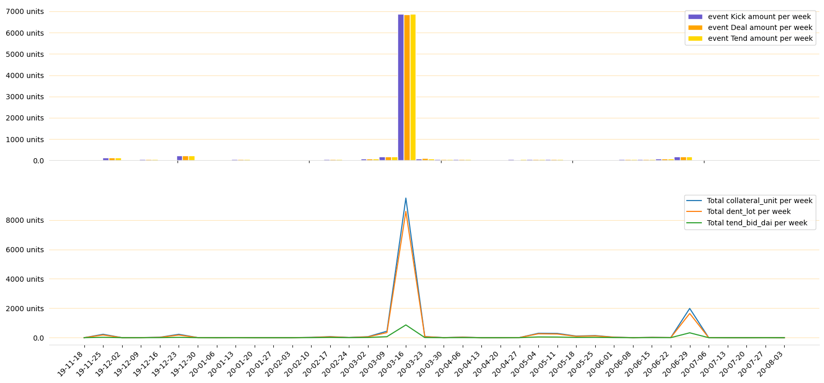
Liquidation 1.0

Slide 14
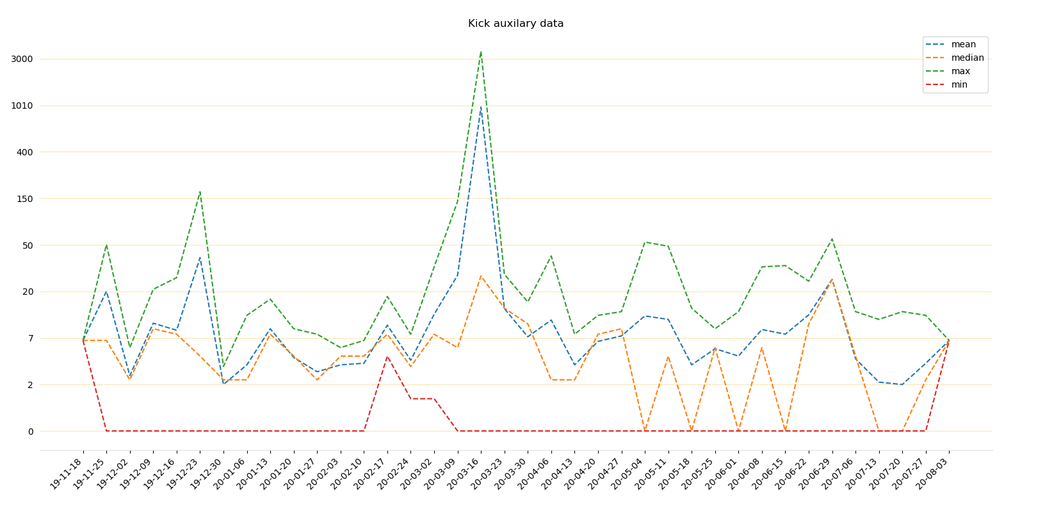
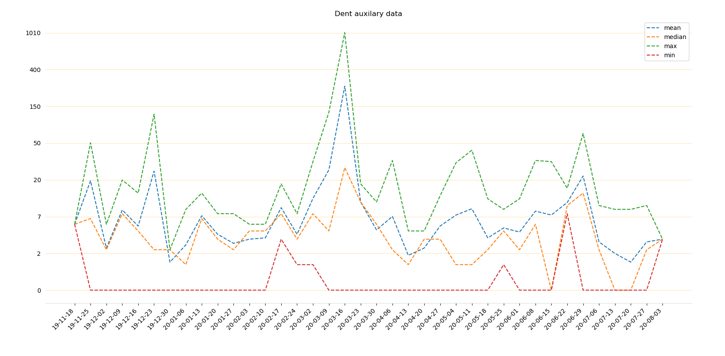
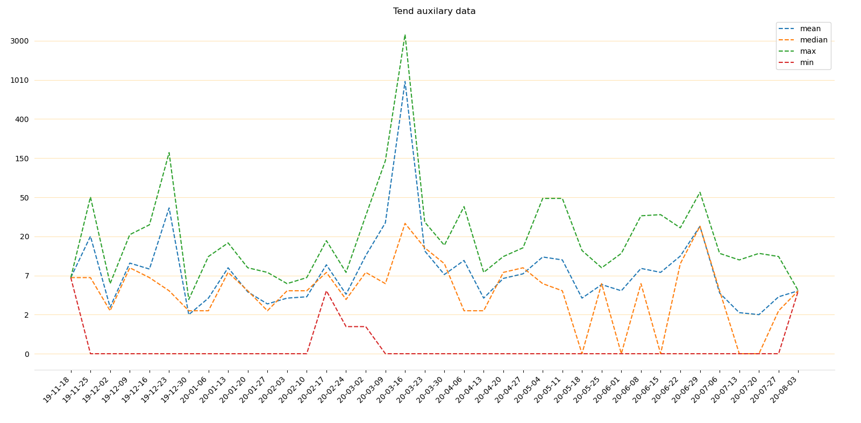
Kick, tend, dent event occur numbers

Slide 15
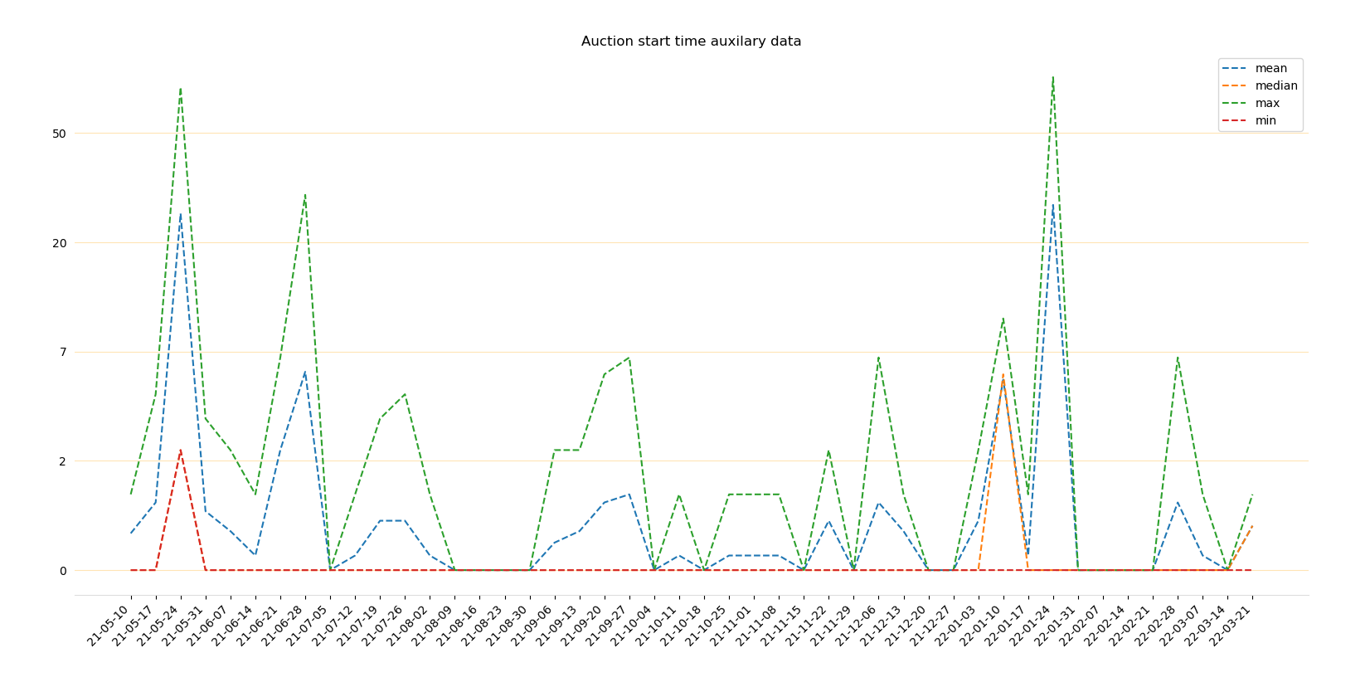
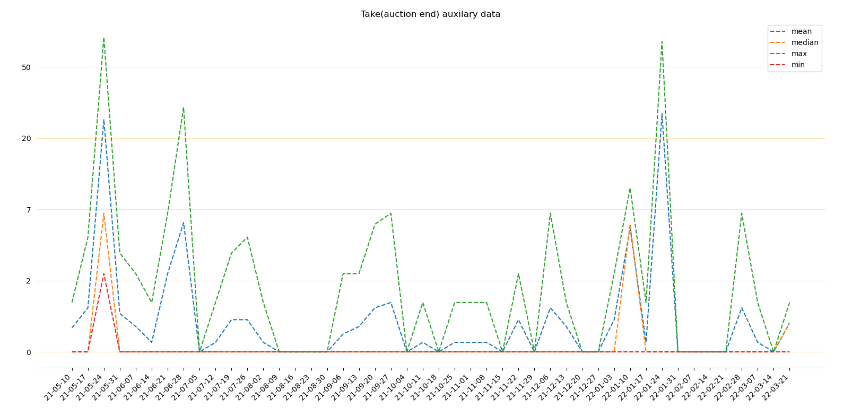
Take and auction start time event occur numer

Slide 16
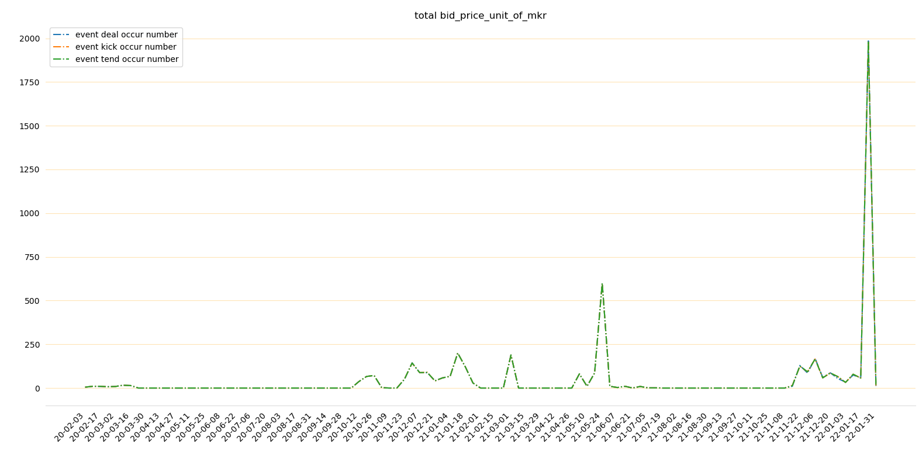
Surplus auction 这三个拟合度太高了，不好分开

Slide 17

9.1 Black Swan

Slide 18
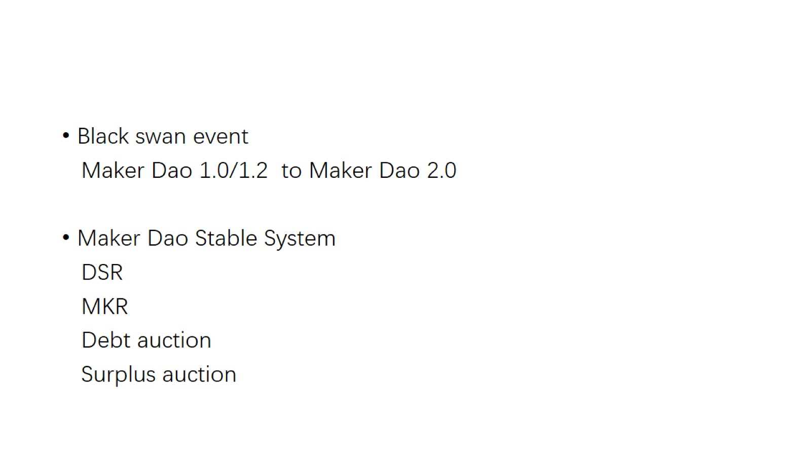

Slide 19
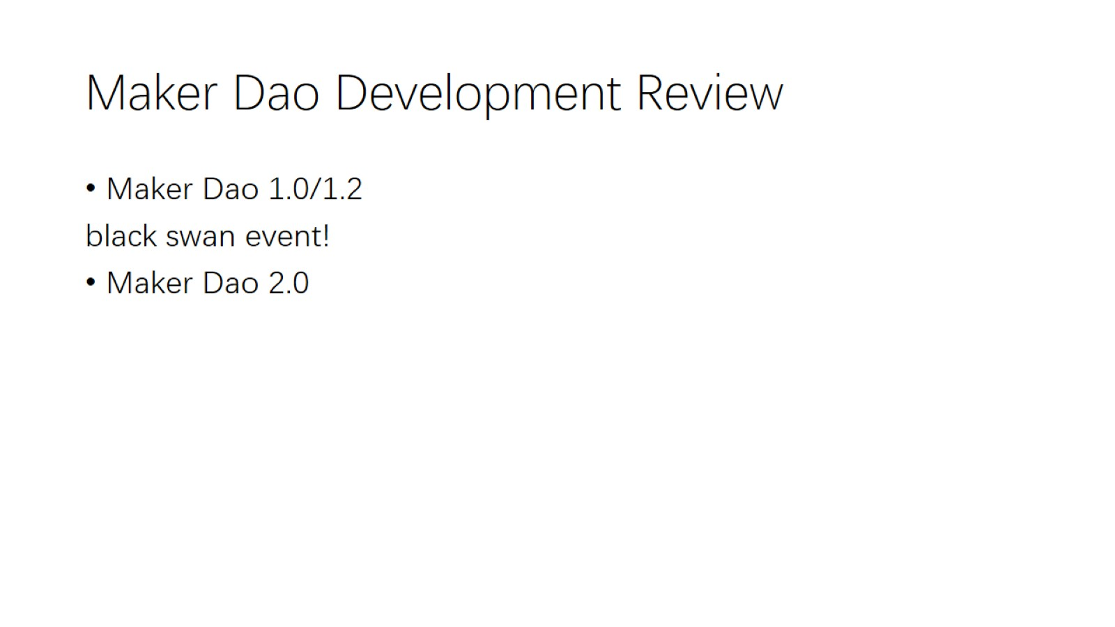
Maker Dao Development Review

Slide 20
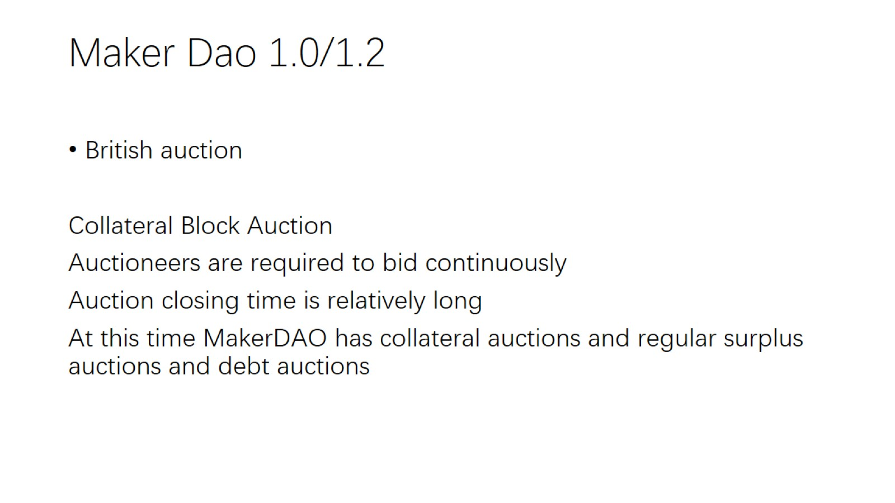
Maker Dao 1.0/1.2

Slide 21
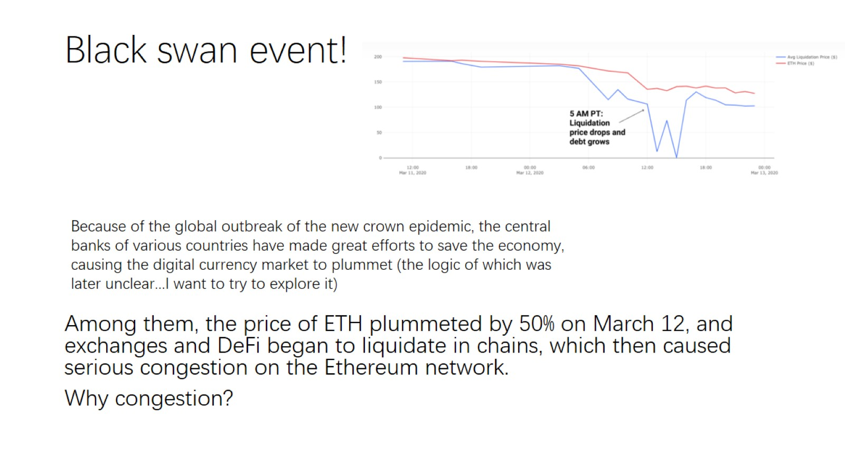
Black swan event!

Slide 22
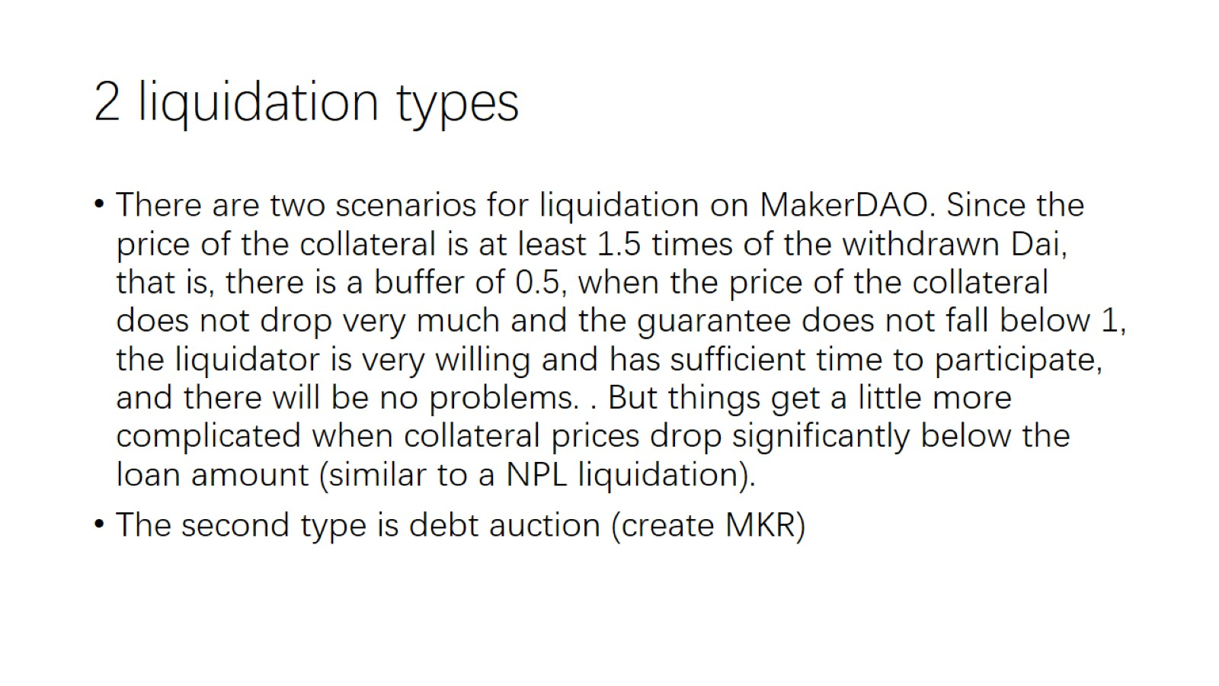
2 liquidation types

Slide 23
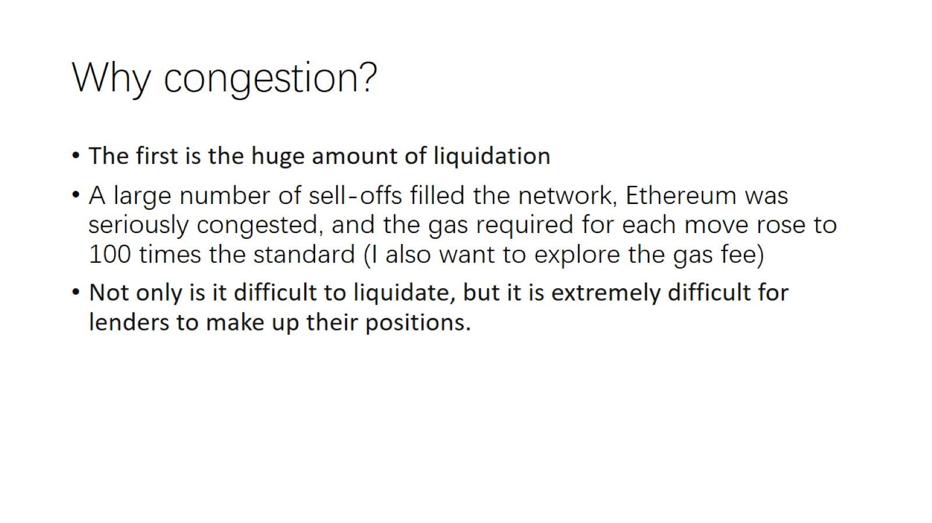
Why congestion?

Slide 24
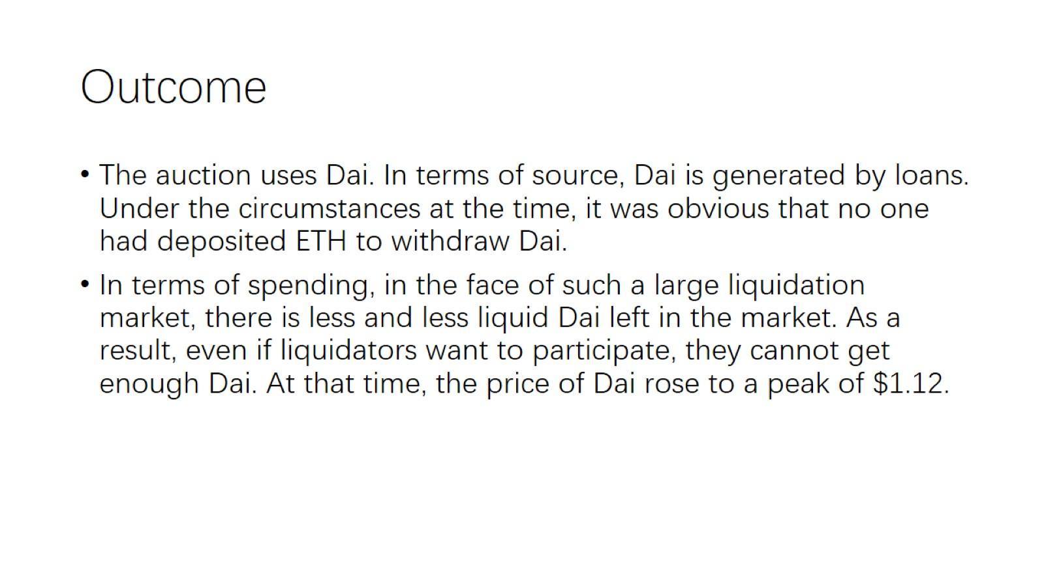
Outcome

Slide 25
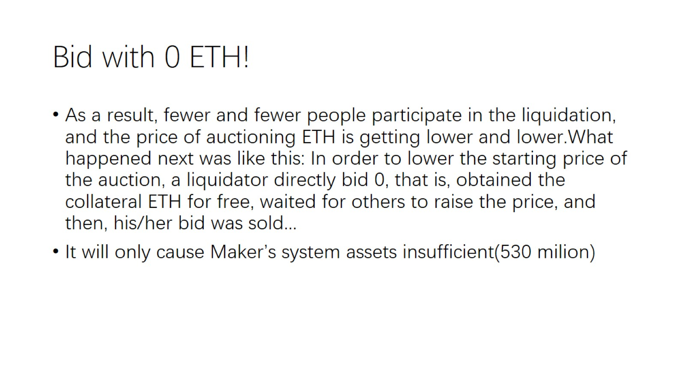
Bid with 0 ETH!

Slide 26
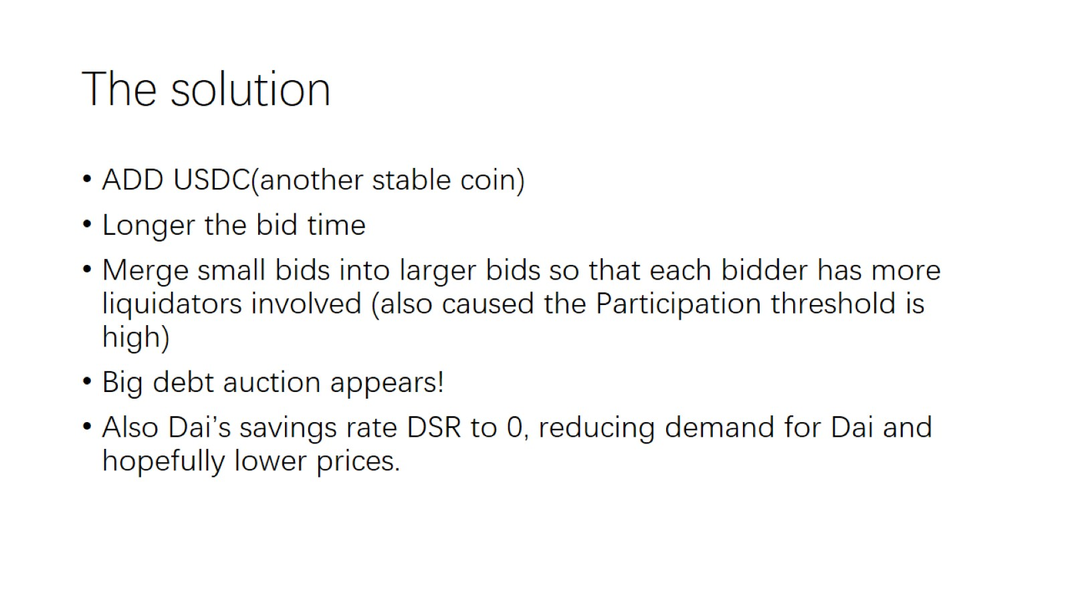
The solution

Slide 27

9.2 D3M (AAVE and Maker DAO)
MakerDAO recently announced a partnership with Aave to implement the DAI Direct Deposit Module (D3M) to minimize the uncertainty of borrowing DAI through Aave.

Slide 28
What happen
DAI users are reluctant to borrow due to different interest rates prevailing in DeFi
It solves the problem by enforcing a maximum lending rate. The maximum borrowing rate is the maximum rate at which the loan issued will accrue interest over time, which can only be repaid by the borrower.
In the words of Dragonfly Capital managing partner Haseeb Qureshi, the D3M module “makes Aave feel like a commercial bank on top of MakerDAO’s central bank.” The token liquidity provided by Aave on L2 will allow Maker to solidify its position on L2 as the primary provider of stablecoins, while its users can enjoy the security provided by the collateral stored in L1.
解释DAI从哪里来是否在印前，回报是要lock还是如何，incentive ，economic theory

Slide 29
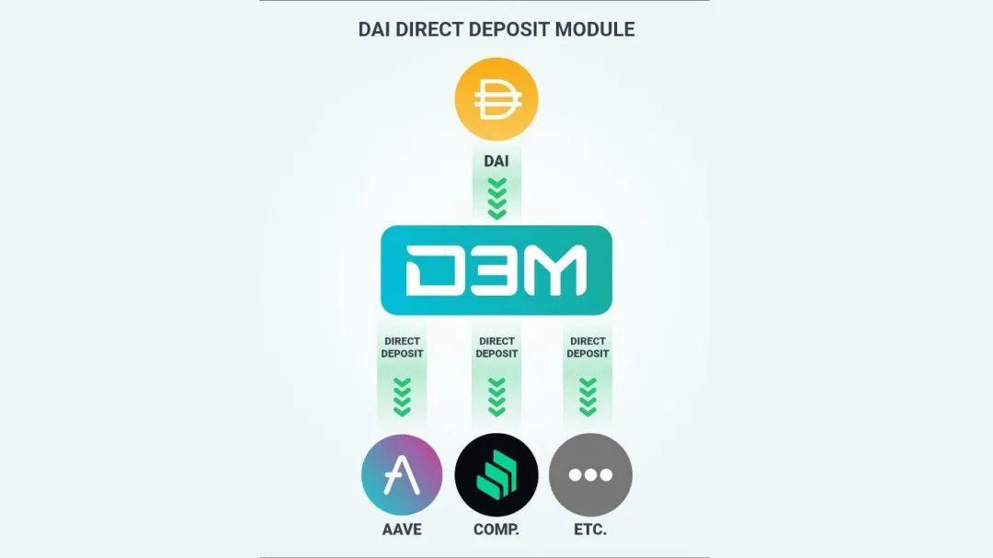
D3M brings an innovative strategy to create DAI on the Aave protocol
Basically, the MakerDAO community can modify the target borrowing rate for DAI on Aave to ensure maximum competitiveness of the token on the protocol. D3M functionally allows Aave users to borrow DAI at a fixed maximum interest rate (currently 4%), as the collateral stored on Aave is used to offset the additional interest

Slide 30
Influence
Maker benefits from increased liquidity in its stablecoin as Aave users will now be encouraged to borrow after extreme volatility in stability fees eases.
Thanks to D3M, Maker is also less reliant on USDC to expand DAI supply.
The interest on aDAI resulting from depositing DAI in the Aave protocol will serve as an external source of income for Maker.

Slide 31

9.4. Compare Maker Dao and LUSD (Whether really decentralized)
LUSD first use Dutch auction!

Slide 32
LUSD first use Dutch auction!
It is not maker that use Dutch auction first.
The first-mover advantage of stable coins is easy to defend and difficult to attack, just like the obvious problem of USDT, but given the high transfer cost, USDT still occupies the first place in the market value of stable coins.
So LUSD ?? Dutch??

Slide 33
Liquity！
From Footprint Analytics, there is a clear gap between MakerDao and Liquity in TVL, which is about 7.6 times that of Liquity, and the market value of DAI is also nearly 12 times that of LUSD.
However, as a latecomer to the over-collateralized stablecoin market, Liquity naturally has to learn from the previous experience. Many mechanisms of Liquity are set for the pain points of MarkerDao.。

Slide 34
Maker Dao and Liquity
1. Lending process
2. Stablecoin mechanism
3. Governance token
4. Liquidation mechanism

Slide 35
Lending process- collateral
Compared with Liquity, which can only pledge ETH, MakerDao allows multiple collaterals
Liquity believes that LUSD is a decentralized stable currency and using ETH as collateral is the real decentralization. However, there are centralized institutions behind such as USDT, and the stable coins produced from this are actually still centralized.
MakerDao also only supported ETH as collateral before March 2020, but the sharp drop in the price of ETH in March 2020 accelerated MakerDao's decision to support multiple collaterals, and the opening of USDC during the crisis allowed DAI to recover fluidity.

Slide 36
Lending process- collateral
Multi-collateral is a double-edged sword. On the one hand, stablecoins such as USDT can diversify platform risks and adjust the supply and demand of DAI. On the other hand, stablecoins with USDT as collateral also have many risks, such as being sued by the SEC or insufficiently regulated by the reserve fund. At the same time, the rise and fall of other platform tokens are also highly correlated with the rise and fall of ETH.
Based on the security of the platform, it is impossible to conclude whether MakerDao or Liquity is more secure, but as a user's optionality, the options given by MakerDao will be more diverse.

Slide 37
Lending process - Interest and Minimum Mortgage Rates
MakerDao charges a fixed interest (Stability Fee) when borrowing, and the rate varies according to different assets and different minimum mortgage rates.
For example, ETH has 3 pools. The minimum mortgage rates from low to high are 130%, 145%, and 170%, respectively, and the corresponding fixed interest is 5%, 2%, and 0.5%. Except for some stable coins and LP Token, the minimum mortgage rate is lower, and the minimum mortgage rate of other token pools is above 130%. The higher the mortgage rate, the lower the capital utilization rate.

Slide 38
Lending process - Interest and Minimum Mortgage Rates
For users on Liquity, the minimum mortgage rate is only 110%, and there is no borrowing rate that increases over time. Although Liquity still has a borrowing fee of 0.5%-5%, this fee is a one-time fee that does not increase over time. This makes Liquity's users more inclined to use borrowing for a long time and is not eager to repay, thus helping Liquity's TVL to remain relatively stable.

Slide 39
Stablecoin mechanism
DAI
MakerDao regulates the supply and demand of DAI through Stability Fee and Deposit Interest (DSR), but these adjustments are based on the judgment of MakerDAO members, and it goes back to the question of whether MakerDao is sufficiently decentralized!
LUSD
Allow users to put LUSD into the pool to earn collateral ETH and platform token LQTY rewards for others being liquidated. The amount of income depends on how many people will be liquidated. When the market is more unstable, the rapid decline in the price of ETH will increase the income of the stable pool.
People are more willing to invest with DAI, while LUSD remains in the original system

Slide 40
Governance token
MKR
The supply of MKR does not have a fixed amount, it mainly depends on the debt situation of the entire MarkerDao.
LQTY
And LQTY will not participate in the liquidation of debt, and its supply is only 100 million. The main source of LQTY comes from investing LUSD in its stable pool to get rewards. Users can also pledge the LQTY obtained to share the borrowing and redemption costs of other users. LQTY is mainly used to motivate users to invest their lent LUSD into its stable pool to improve the clearing mechanism, which explains why more than 60% of LUSD is still in Liquity's own system.

Slide 41
Governance token
MKR
MKR is a governance token that allows voting on protocol parameters (such as stability fees, debt ceilings, minimum collateralization ratios) as well as important ecosystem things (such as funding working groups, grants, etc.). But most of MKR is held by early investors and big players, which makes MakerDao fall into the whirlpool of centralization.
LQTY
And LQTY is not a governance token, its use case is only to help holders capture profits, so it can be seen from the price of the two that the difference is as much as 400 times. The circulating supply of the token LQTY is still rising steadily before it is fully released, while the circulating supply of MKR will basically remain stable when the market is stable.

